Slide 1
Course Revision
(networking part)

Slide 2
Computer networking basics
  What is a computer network ? A computer network is an interconnected collection of autonomous computers.
  Why are people interested in networks ?
    For companies: Resource sharing, high reliability, saving money, scalability, and powerful communication medium.
    For people: Access to remote information, Person-to-person communication, and Interactive entertainment.

Slide 3
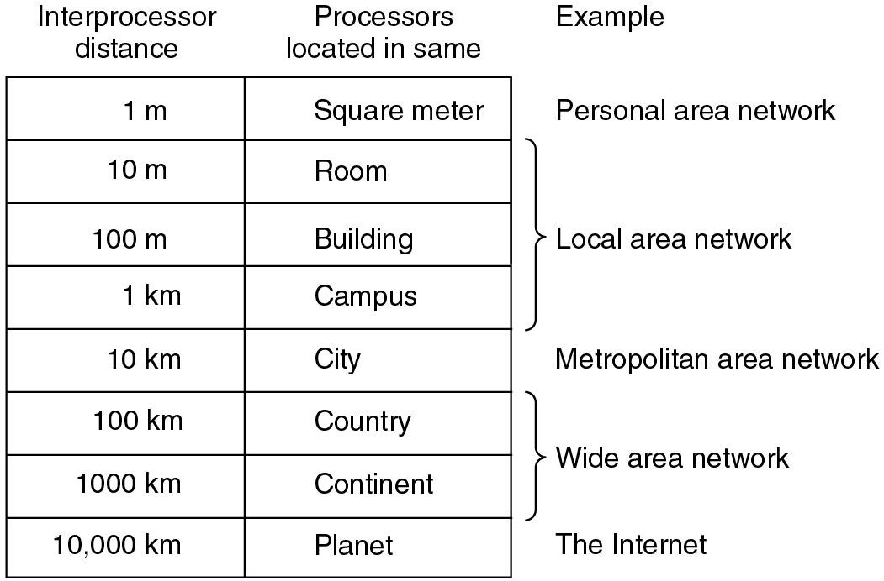
Network hardware
Classification on interconnected processors by scale.

Slide 4
Network software
  Protocol hierarchies:
    Layers: number, name, functions.
    Protocols: the rules and conventions used in a conversation between layer K on one machine and layer K on another machine.
    Interface: primitive operations and services the lower layer offers to the upper layer.
    Architecture: the set of layers and protocols (to enable the implementor to write programs for each layer).

Slide 5
Network software (2)
  Key design issues for the layers:
    Connection management,
    error control,
    flow control,
    congestion control,
    disassembling/reassembling/sequencing, and
    routing.

Slide 6
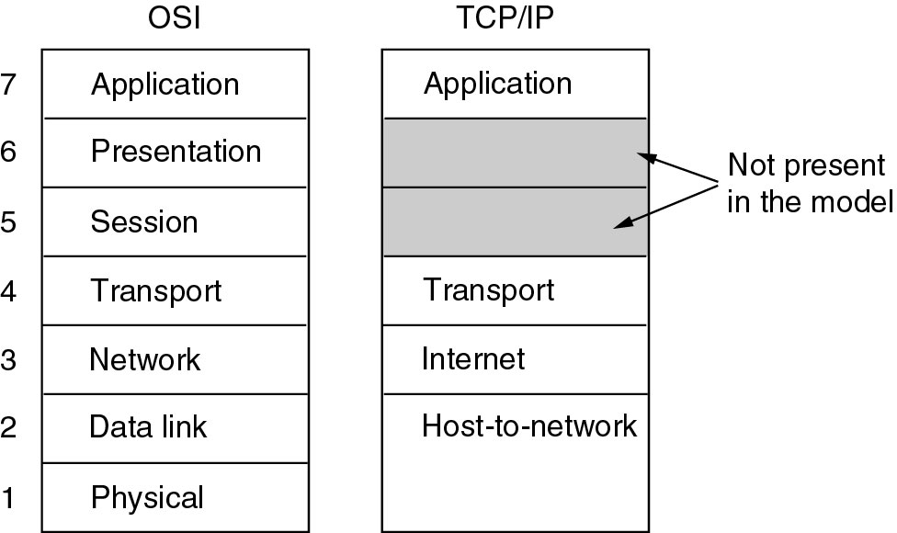
OSI and TCP/IP reference models

Slide 7
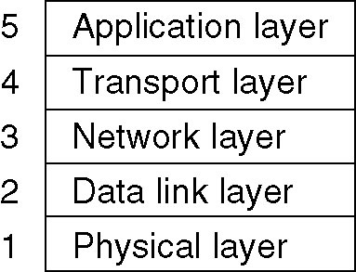
Hybrid Model
The OSI model minus the session and presentation layers is exceptionally useful for discussing computer networks, but the OSI protocols have not become popular.
The TCP/IP model is practically nonexistent, but the protocols are widely used.
The following hybrid model has been used in this course.

Slide 8
The physical layer
The physical layer is concerned with transmitting raw bits over a communication channel.
Principal transmission media: twisted pair, baseband/ broadband coaxial cable, fiber optics, and satellite.
Circuit switching and packet switching.

Slide 9
The data link layer
Task: convert noisy lines between two adjacent machines into communication channels free of undetected transmission error for use by the network layer.
Issues:
  Framing: e.g., starting and ending characters/flags.
  Error control: Error detection and correction codes. Acknowledgment, retransmission (timer, buffer, sequencing), piggybacking.
  Flow control: Feedback mechanism (acknowledgment, buffer).
Sliding window protocols:
  Stop-and-wait: one bit sequence number, window size 1.
  Pipelining:
    Go back n:
    receiving window size = 1. Sending window size = MaxSeq.
    Selective repeat: Sending/receiving window size = (MaxSeq + 1 )/2.
    Review Assignment I.

Slide 10
The medium access sublayer
Channel allocation: a common issue in networks (mainly LANs) which have a single shared channel for all communication.
Channel allocation algorithms:
  ALOHA: pure/slotted.
  Contention protocols: CSMA.
  CSMA/CD: collision detection.
IEEE 802 LANs:
  CSMA/CD (Ethernet).
  Fast Ethernet
  Gigabit Ethernet

Slide 11
The network layer
Task: get packets from the source all the way to the destination.
External services: connection-oriented versus connectionless service.
Internal organization: virtual circuits versus datagrams.
Routing algorithms: correctness, simplicity, robustness, stability, fairness, and optimality:
  Shortest path.
  Flooding
  Distance vector routing
  Link state routing
  Hierarchical routing
  Routing for mobile hosts

Slide 12
The network layer (2)
Congestion control algorithm: prevent throughput drop-off due to too many packets in the subnet :
  Traffic shaping
  Congestion control in virtual circuit subnet
  Choke packets
  Packet discarding
  Load shedding
Internetworking: connecting two or more networks together.
  Two general approaches: concatenated virtual circuits and connectionless internetworking
  Tunneling
The network layer (protocols and algorithms) in the Internet.

Slide 13
The transport layer
The main task of the transport layer is to provide a reliable, cost-effective data transport from the source machine to the des-tination machine, independent of the physical networks in use.
Elements of transport protocols:
  Addressing.
  Connection establishment: three-way handshake.
  Connection release: two-army problem. Three-way handshake.
  Flow control and buffering: shared buffer, dynamic buffer allocation (variable-sized window).
The transport layer (protocols and algorithms) in the Internet.

